Slide 1
3
APPLICATIONS OF
DIFFERENTIATION

Slide 2
Antiderivatives
3.7

Slide 3
INTRODUCTION
A physicist who knows the velocity of a particle might wish to know its position at a given time.
An engineer who can measure the variable rate at which water is leaking from a tank wants to know the amount leaked over a certain time period.
A biologist who knows the rate at which a bacteria population is increasing might want to deduce what the size of the population will be at some future time.

Slide 4
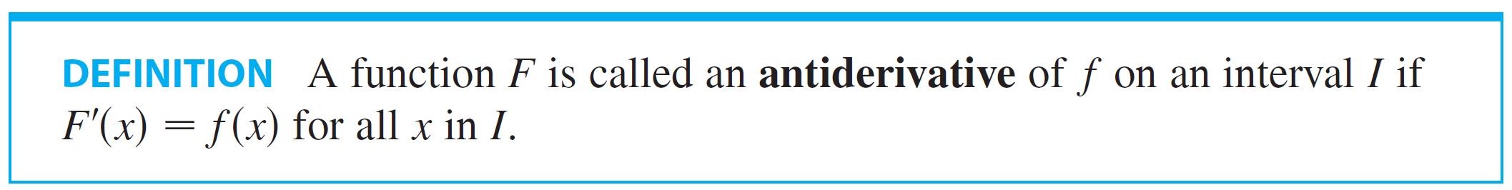
Antiderivatives
The problem is to find a function F whose derivative is a known function f. The following is the formal definition of antiderivative of f. If such a function F exists, it is called an antiderivative of f.

Slide 5

Antiderivatives
For instance, let f(x)= x². It isn’t difficult to discover an antiderivative of f if we keep the Power Rule in mind. In fact, if then
But the function also satisfies Therefore both F and G are antiderivatives of f. Indeed, any function in the form where C is a constant, is an antiderivative of f.
The question arises: Are there any others?

Slide 6
Antiderivatives
To answer this question, recall that in Section 3.2 we used the Mean Value Theorem to prove that if two functions have identical derivatives on an interval, then they must differ by a constant (Corollary 3.2.7). Thus if F and G are any two antiderivatives of f, then
so G(x) – F(x) = C, where C is a constant.

Slide 7

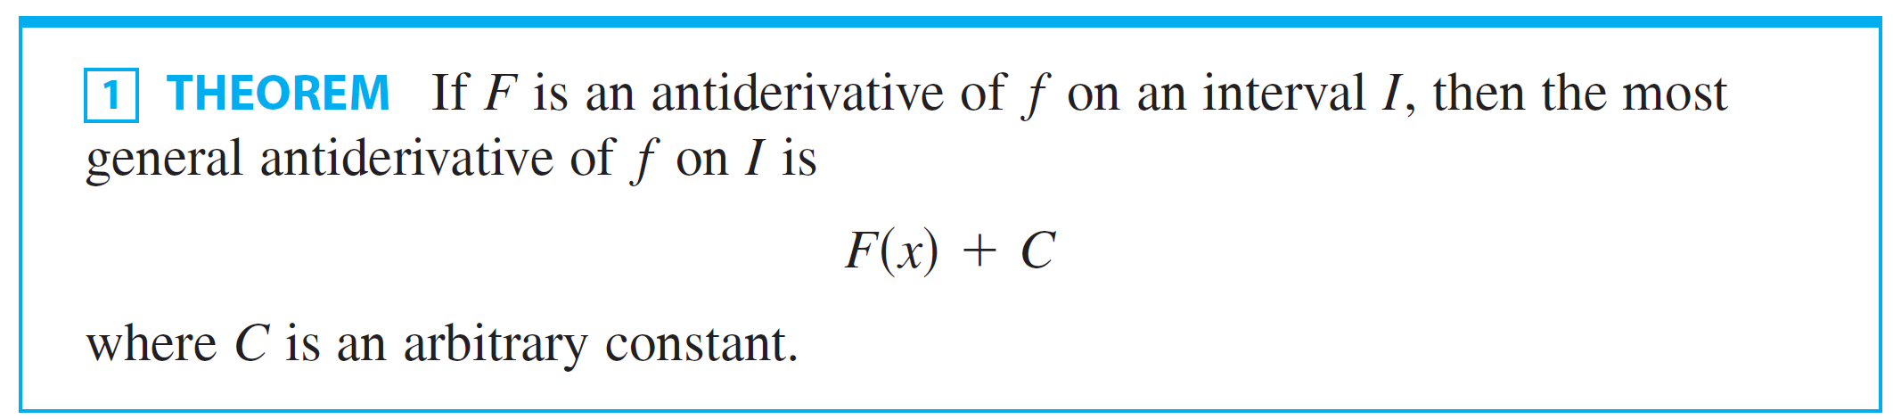
Antiderivatives
We can write this as , so we have the following result.

Slide 8

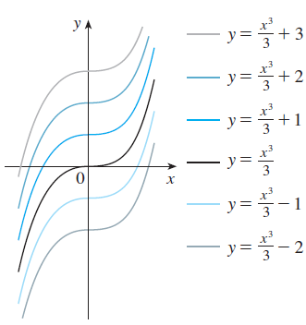

Antiderivatives
Going back to the function
we see that the general antiderivative
of f is By assigning specific
values to the constant C, we obtain a
family of functions whose graphs are
vertical translates of one another
(see Figure 1).
This make sense because each curve
must have the same slope at any given
value of x.

Slide 9
Example 1
Find the most general antiderivative of each function.
f(x) = sin x
f(x) = x^{n}, n ≥ 0
f(x) = x^{–3}

Slide 10
Example 1(a) SOLUTION
If F(x) = – cos x, then F’(x) = sin x.
So, an antiderivative of sin x is – cos x.
By Theorem 1, the most general antiderivative is: G(x) = – cos x + C

Slide 11
Example 1(b) SOLUTION
We use the Power Rule to discover an antiderivative of x^{n}:
Thus, the general antiderivative of f(x) = x^{n} is:
This is valid for n ≥ 0 because then f(x) = x^{n} is defined on an interval.

Slide 12
Example 1(c) SOLUTION
If we put n = – 3 in (b), we get the particular antiderivative F(x) = x ^{–2}/(– 2) by the same calculation.
However, notice that f(x) = x –3 is not defined at x = 0.

Slide 13
Example 1(c) SOLUTION
Thus, Theorem 1 tells us only that the general antiderivative of f is x⁻²/(– 2) + C on any interval that does not contain 0.
So, the general antiderivative of f(x) = 1/x3 is:

Slide 14
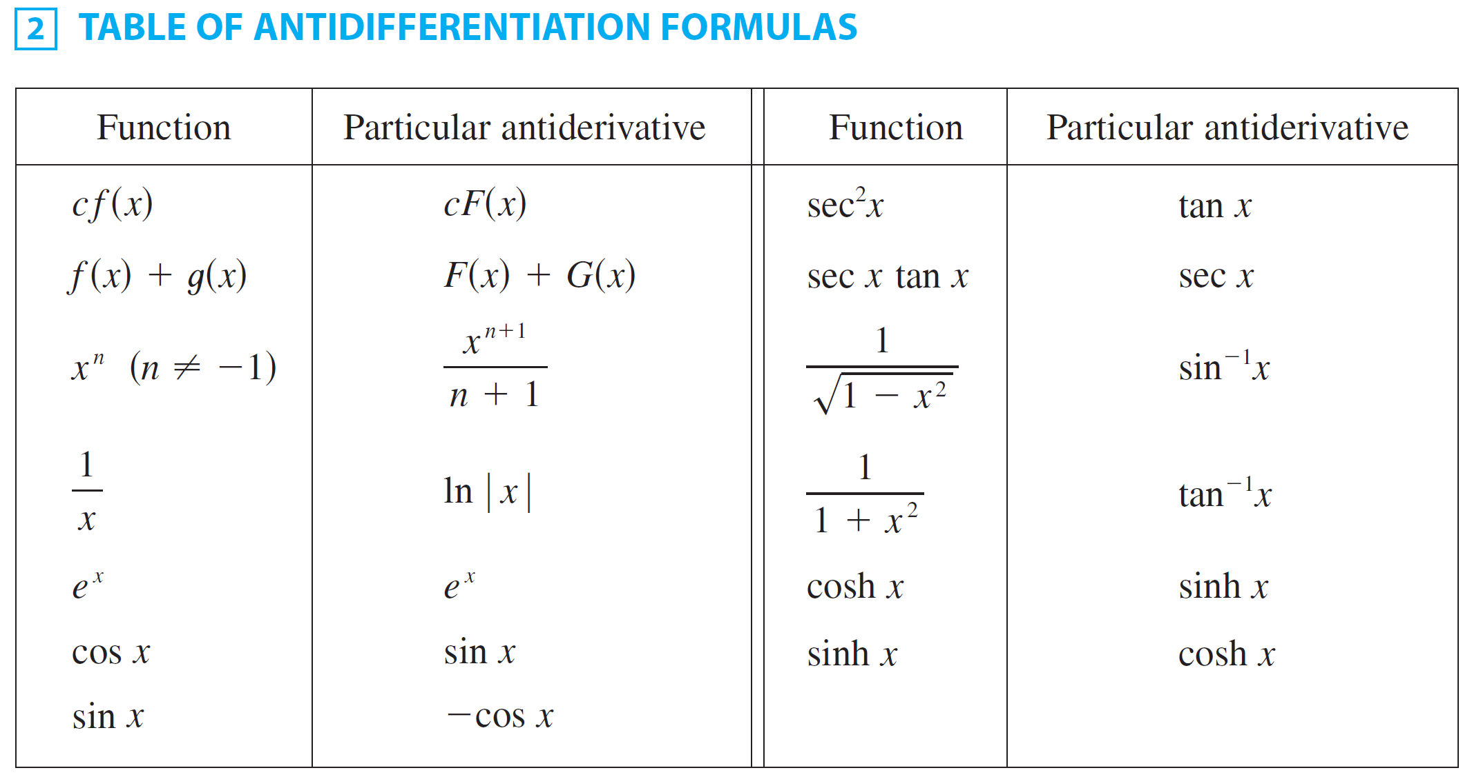
Antiderivatives
In Table 2 we list some particular antiderivatives.

Slide 15
Antiderivatives
Each formula in the table is true because the derivative of the function in the right column appears in the left column.
In particular, the first formula says that the antiderivative of a constant times a function is the constant times the antiderivative of the function.
The second formula says that the antiderivative of a sum is the sum of the antiderivatives. (We use the notation )

Slide 16
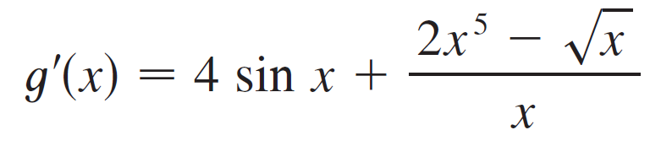
Example 2
Find all functions g such that

Slide 17
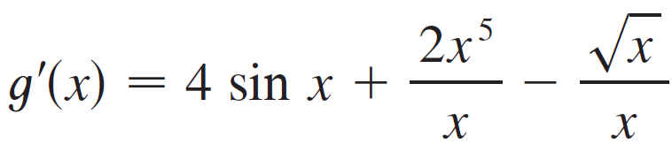
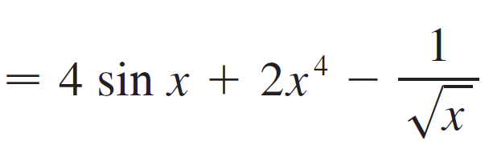
Example 2 – Solution
SOLUTION:
We first rewrite the given function as follows:

Slide 18
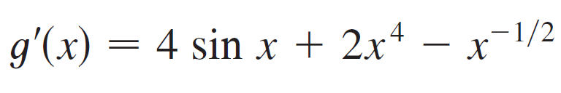
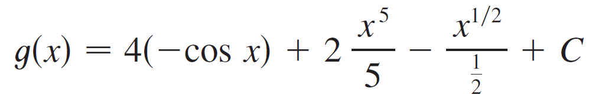
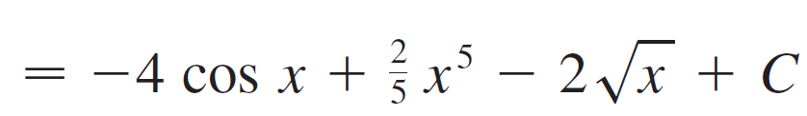
Example 2 – Solution
cont’d
Thus we want to find an antiderivative of
Using the formulas in Table 2 together with Theorem 1, we obtain

Slide 19
Antiderivatives
In applications of calculus it is very common to have a situation as in Example 2, where it is required to find a function, given knowledge about its derivatives.
An equation that involves the derivatives of a function is called a differential equation.
The general solution of a differential equation involves an arbitrary constant (or constants) as in Example 2. However,
there may be some extra conditions given that will determine the constants and therefore uniquely specific the solution.

Slide 20
Example 3
Find f if f ’(x) = and f(1) = 2.
SOLUTION
The general antiderivative of

Slide 21
Example 3 SOLUTION
To determine C, we use the fact that f(1) = 2: f(1) = 2/5 + C = 2
Thus, we have: C = 2 – 2/5 = 8/5
So, the particular solution is:

Slide 22

Example 4
Find f if , f (0) = 4, and f(1) = 1.

Slide 23

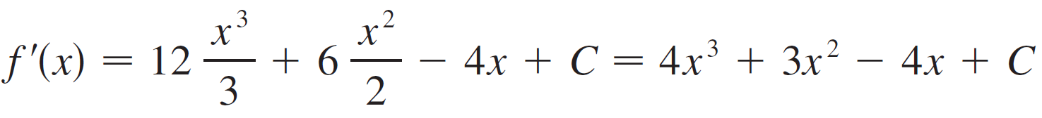
Example 4 – Solution
SOLUTION:
The general antiderivative of is

Slide 24
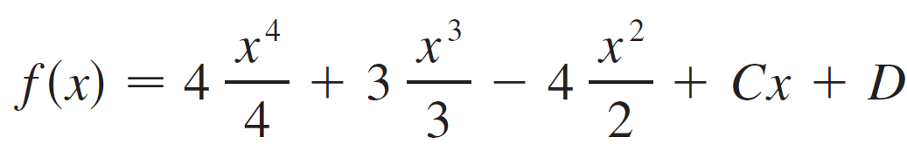
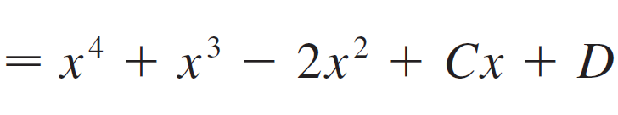
Example 4 – Solution
cont’d
Using the antidifferentiation rules once more, we find that
To determine C and D we use the given conditions that f(0) = 4 and f(1) = 1.
Since f(0) = 0 + D = 4, we have D = 4.

Slide 25
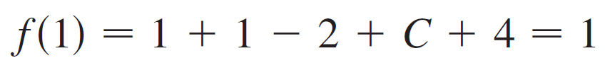

Example 4 – Solution
cont’d
Since
we have C = –3 .
Therefore the required function is

Slide 26
Rectilinear Motion

Slide 27
Rectilinear Motion
Antidifferentiation is particularly useful in analyzing the motion of an object moving in a straight line.
Recall that if the object has position function s = f(t), then the velocity function is v(t) = s ′(t).
This means that the position function is an antiderivative of the velocity function.
Likewise, the acceleration function is a(t) = v ′(t), so the velocity function is an antiderivative of the acceleration.

Slide 28
Rectilinear Motion
If the acceleration and the initial values s(0) and v(0) are known, then the position function can be found by antidifferentiating twice.
An object near the surface of the earth is subject to a gravitational force that produces a downward acceleration denoted by g.
For motion close to the ground we may assume that g is constant, its value being about 9.8 m/s² (or 32 ft/s²).

Slide 29
Example 5
A particle moves in a straight line and has acceleration given by a(t) = 6t + 4.
Its initial velocity is v(0) = – 6 cm/s and its initial displacement is s(0) = 9 cm.
Find its position function s(t).

Slide 30
Example 5 SOLUTION
As v’(t) = a(t) = 6t + 4, antidifferentiation gives:
Note that v(0) = C.
However, we are given that v(0) = – 6, so C = – 6.
Therefore, we have: v(t) = 3t2 + 4t – 6

Slide 31
Example 5 SOLUTION
As v(t) = s’(t), s is the antiderivative of v:
This gives s(0) = D.
We are given that s(0) = 9, so D = 9.
The required position function is: s(t) = t³ + 2t ² – 6t + 9

Slide 32
Example 5 SOLUTION
An object near the surface of the earth is subject to a gravitational force that produces a downward acceleration denoted by g.
For motion close to the ground, we may assume that g is constant.
Its value is about 9.8 m/s² (or 32 ft/s²).

Slide 33
Example 6
A ball is thrown upward with a speed of 48 ft/s from the edge of a cliff 432 ft above the ground.
Find its height above the ground t seconds later.
When does it reach its maximum height?
When does it hit the ground?

Slide 34
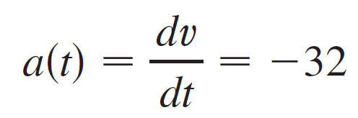

Example 6 – Solution
SOLUTION:
The motion is vertical and we choose the positive direction to be upward. At time t the distance above the ground is s(t) and the velocity is v(t) decreasing. Therefore the acceleration must be negative and we have
Taking antiderivatives, we have

Slide 35
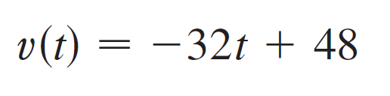
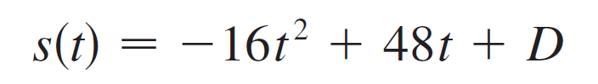
Example 6 – Solution
cont’d
To determine C we use the given information that v(0) = 48.
This gives 48 = 0 + C, so
The maximum height is reached when v(t) = 0, that is, after 1.5 s.
Since s ′(t) = v(t), we antidifferentiate again and obtain

Slide 36

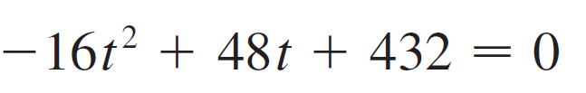
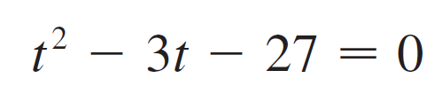
Example 6 – Solution
cont’d
Using the fact that s(0) = 432, we have 432 = 0 + D and so
The expression for s(t) is valid until the ball hits the ground. This happens when s(t) = 0, that is, when
or, equivalently,

Slide 37
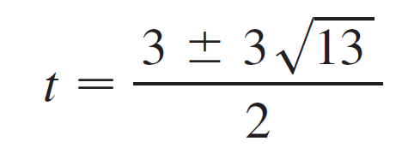
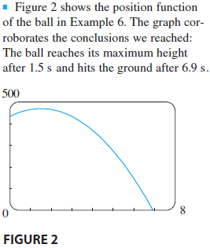
Example 6 – Solution
cont’d
Using the quadratic formula to solve this equation, we get
We reject the solution with the minus
sign since it gives a negative value for
t. Therefore the ball hits the ground
after

